Slide 1


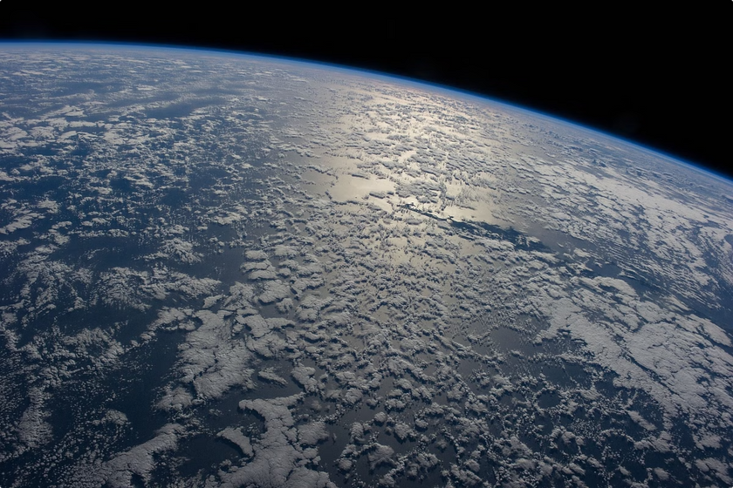

Youth Climate Action Hub: A Climate Education Platform
This Platform acts as a tool raise awareness about climate change and its impacts. Critical issues are explored, understand scientific real time NASA data, and discuss solutions for a sustainable future.
Team Cosmos RedShift
Notes:
1

Slide 2
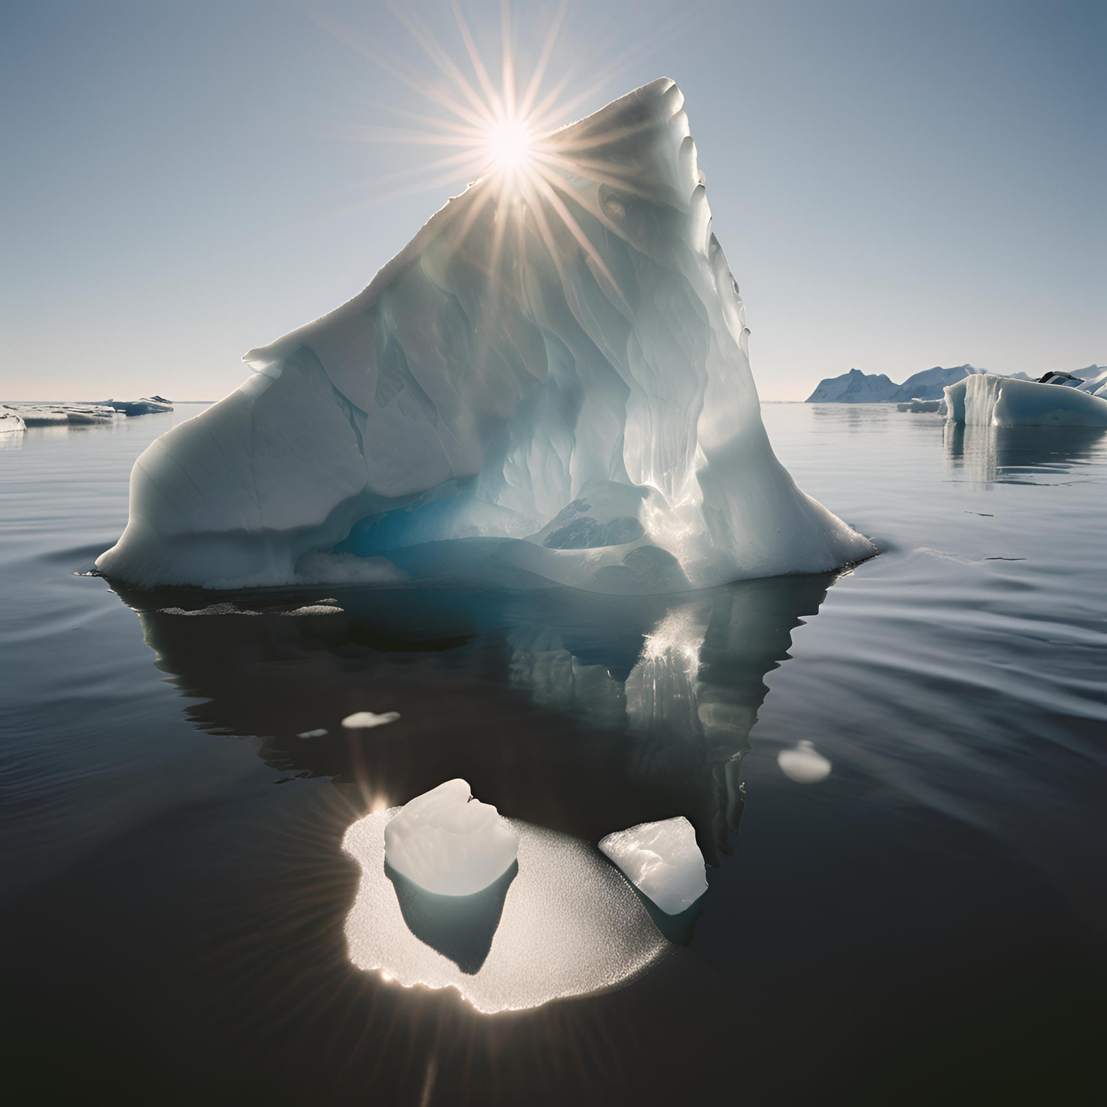
Understanding SDG13
Climate Change: Global Trends
1
SDG13:Climate Action
2
Global Temperature Rise
Take urgent action to combat climate change and its impacts,
Global temperatures are increasing due to human activities, particularly the burning of fossil fuels.
3
Sea Level Rise
4
Extreme Weather Events
Melting glaciers and ice sheets are contributing to rising sea levels, posing a threat to coastal communities.
Climate change is intensifying extreme weather events such as hurricanes, floods, and droughts.
Notes:
2

Slide 3
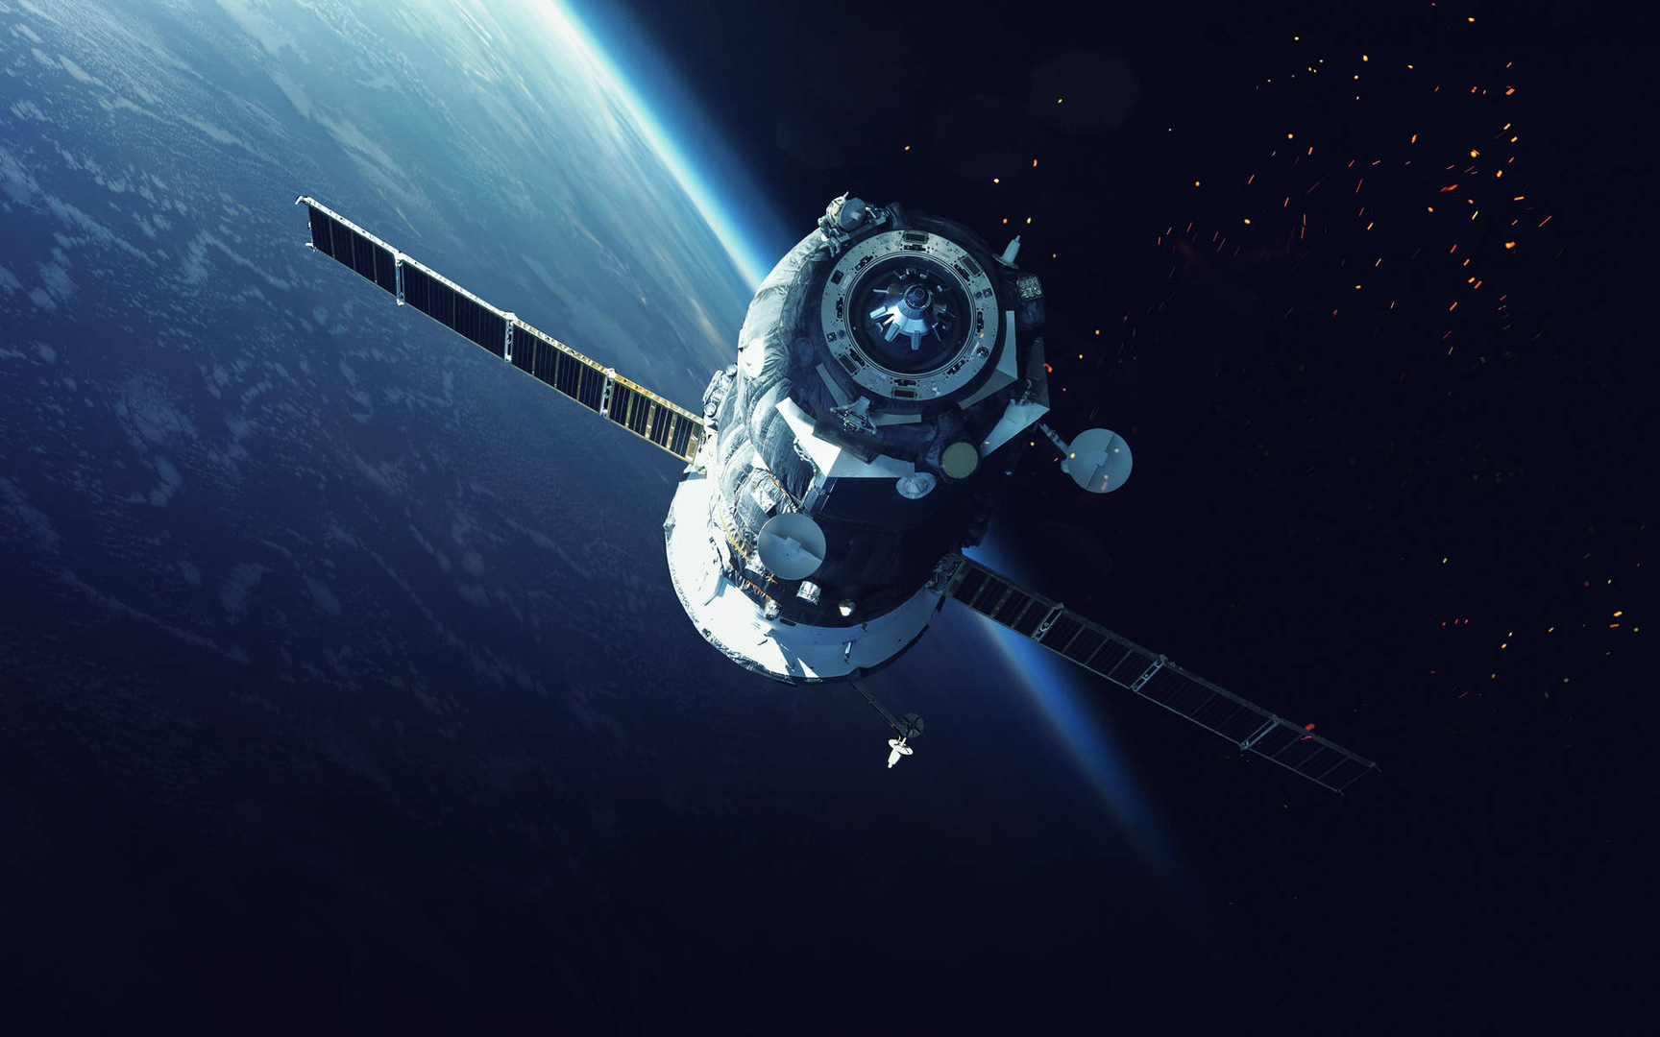
Integrating NASA's Earth Data
1
Temperature Rise
2
CO2 Emissions
Use NASA’s Earth satellites to obtain real-time data on global temperature trends.
Satellites monitor CO2 concentration in the atmosphere showcasing the impact of human activities.
3
Sea Level Rise
4
Arctic Glacier Melt
Monitor rising sea levels and their impacts on coastal regions using NASA’s EarthData tools and their impacts.
Tracking the rapid melting of Arctic glaciers and its contribution to rising sea levels and global climate change.
Notes:
3

Slide 4
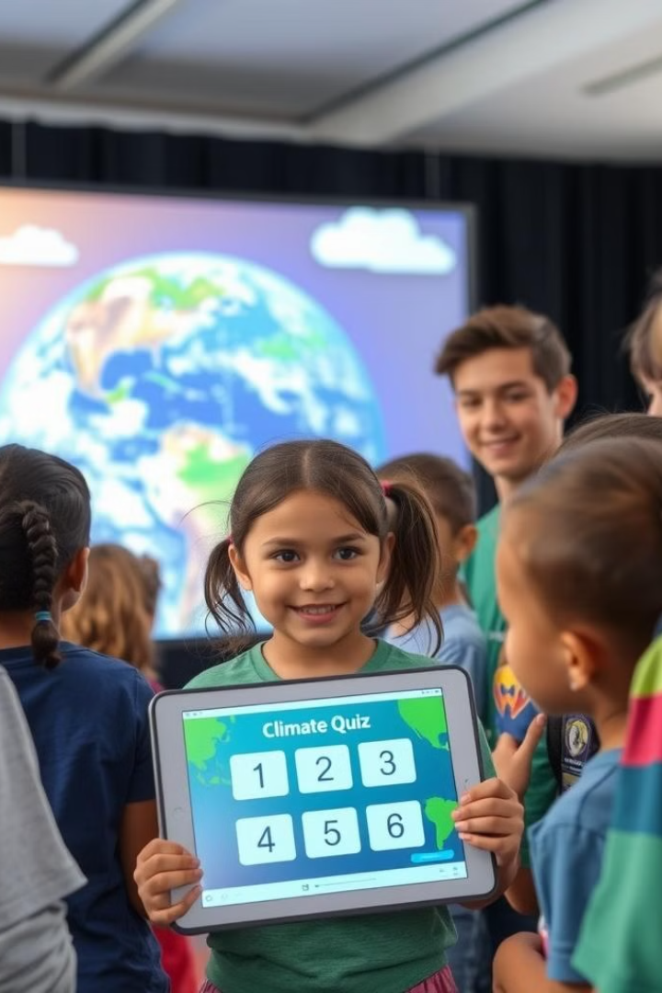
Engaging Curriculum: Climate Stories, Quizzes, and Interactive Games
1
Climate Stories
Engaging narratives explore the impact of climate change on individuals and ecosystems.
2
Interactive Quizzes
Quizzes test knowledge about climate change and encourage active learning.
3
Climate Games
Interactive games provide a fun way to learn about climate change solutions.
Notes:
4

Slide 5
Actionable Solutions: Planting Trees and Renewable Energy
Planting Trees
Renewable Energy
Sustainable Practices
Trees absorb CO2 from the atmosphere, helping to mitigate climate change.
Renewable energy sources like solar and wind power reduce reliance on fossil fuels.
Adopting sustainable practices in our daily lives can contribute to a healthier planet.
Notes:
5

Slide 6
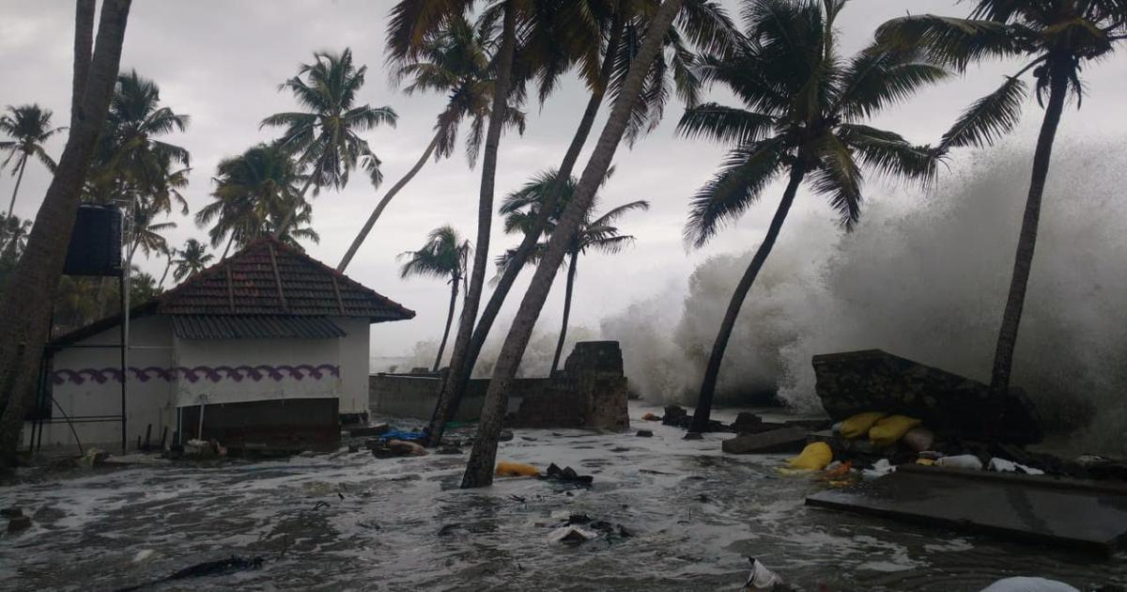



Highlighting Kerala's Climate Impact: Coastal Erosion and Extreme Weather
Coastal Erosion
Rising sea levels and storm surges are causing coastal erosion, threatening infrastructure and livelihoods.
Extreme Rainfall
Increased rainfall is leading to floods and landslides, causing significant damage to property and crops.
Droughts
Droughts are becoming more frequent and severe, impacting agricultural productivity.
Notes:
6

Slide 7
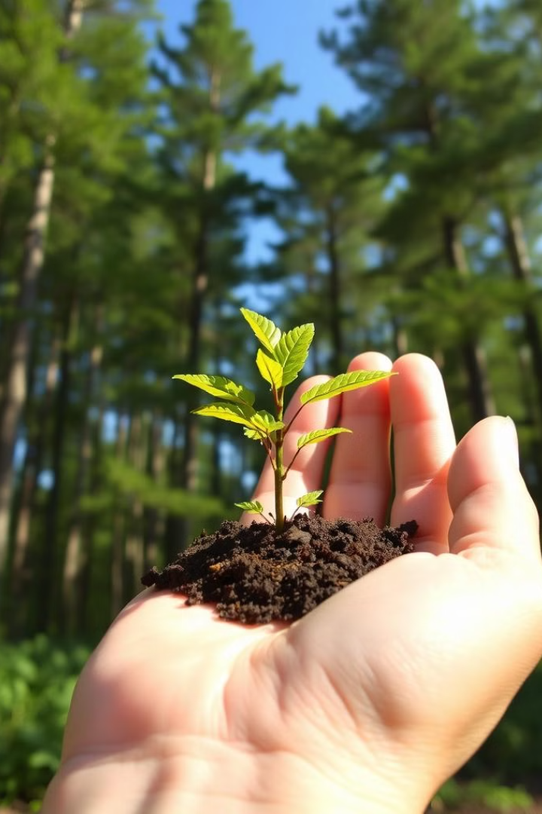
Conclusion
Climate change is a pressing global issue.
In conclusion, addressing global challenges requires a holistic approach to education. Developing a lesson plan around an SDG allows students to explore global issues through a scientific lens, fostering critical thinking and problem-solving. While not directly part of the curriculum, this approach complements science education by emphasizing real-world applications, equipping students to contribute to a sustainable future.
Notes:
7

